Slide 1
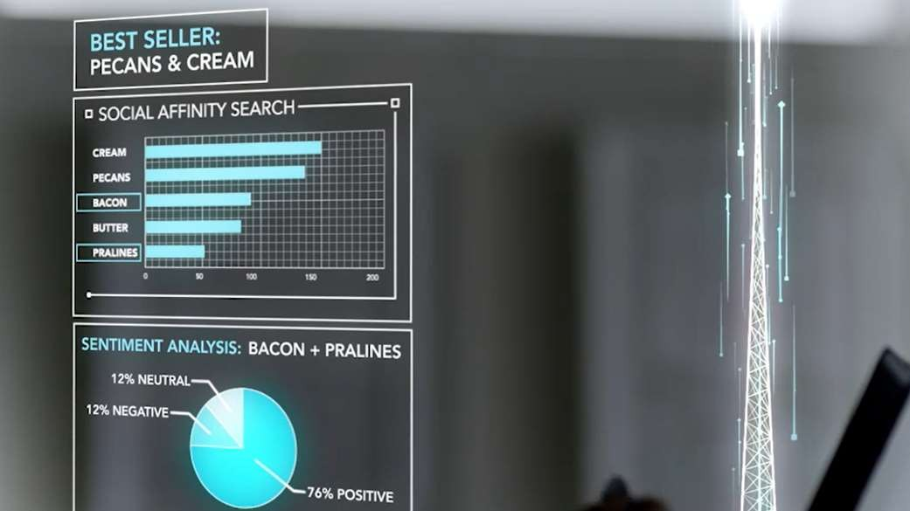


Overview

Slide 2
Free (cran.r-project.org)
Highly extensible
Focused on statistics and machine learning
Transparent and reproducible
Single-threaded
Data stored in memory

Slide 3


1993
Research project in Auckland, NZ
1997
R-core
2003
R Foundation
2009
New York Times
1995
Open source
2000
R-1.0.0
2004
First UseR!
2015
R-3.2.0
R Consortium
Photo credit: Robert Gentleman
3

Slide 4
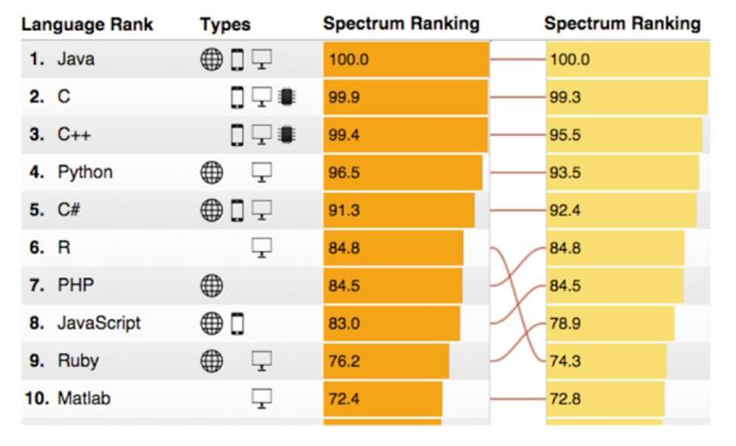
R Usage Growth
Rexer Data Miner Survey, 2007-2013
Language Popularity
IEEE Spectrum Top Programming Languages
#9: R
Rexer Data Miner Survey
IEEE Spectrum July 2015

Slide 5
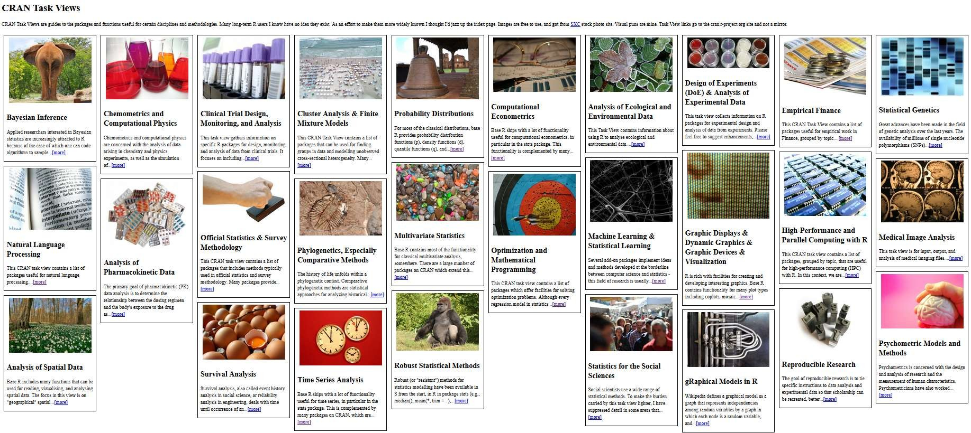
The Comprehensive R Archive Network
In addition to CRAN, Bioconductor, GitHub, others distribute R packages

Slide 6




Slide 7



From Data To Action On Premises
Data Sources
People
Cortana Intelligence
+
Apps
Apps
Sensors and devices
Automated Systems
Microsoft R Server & SQL R Services
DATA
INTELLIGENCE
ACTION

Slide 8
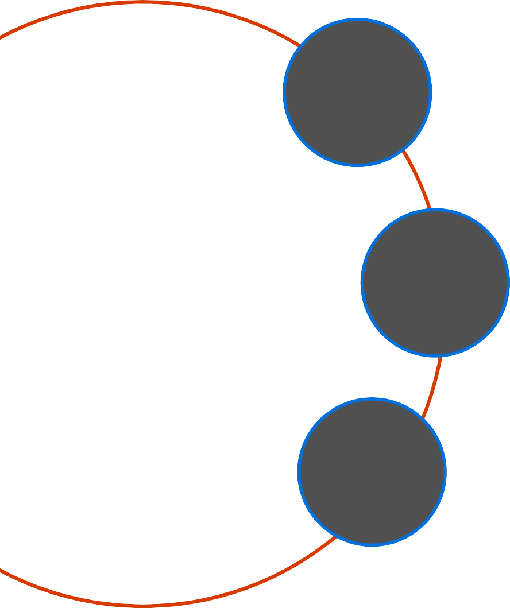

A statistics programming language
A data visualization tool
Open source
Language Platform
What is
2.5+M users
Taught in most universities
New and recent grad’s use it
Thriving user groups worldwide
Community
10,000+ free algorithms in CRAN
Scalable to big data
Rich application & platform integration
Ecosystem

Slide 9
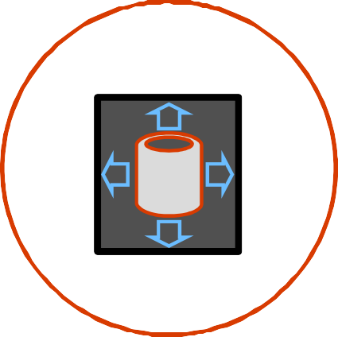



Challenges posed by open source R
?
?
Limited Data Scale
Inadequate Modeling Performance
Lack of Commercial Support
Complex Deployment Processes

Slide 10




R from Microsoft brings
Peace of mind
Efficiency
Speed and scalability
Flexibility and agility

Slide 11




Community
Commercial
SQL Server
R Open
R Services
R Server
Windows
Linux
Hadoop
Teradata
Spark

Slide 12

Escapes R’s traditional memory limits
Scales predictive modeling using parallelization
Distributes computation cores & nodes
Minimizes data movement using in- database, in-MapReduce and in-Apache Spark execution

Slide 13

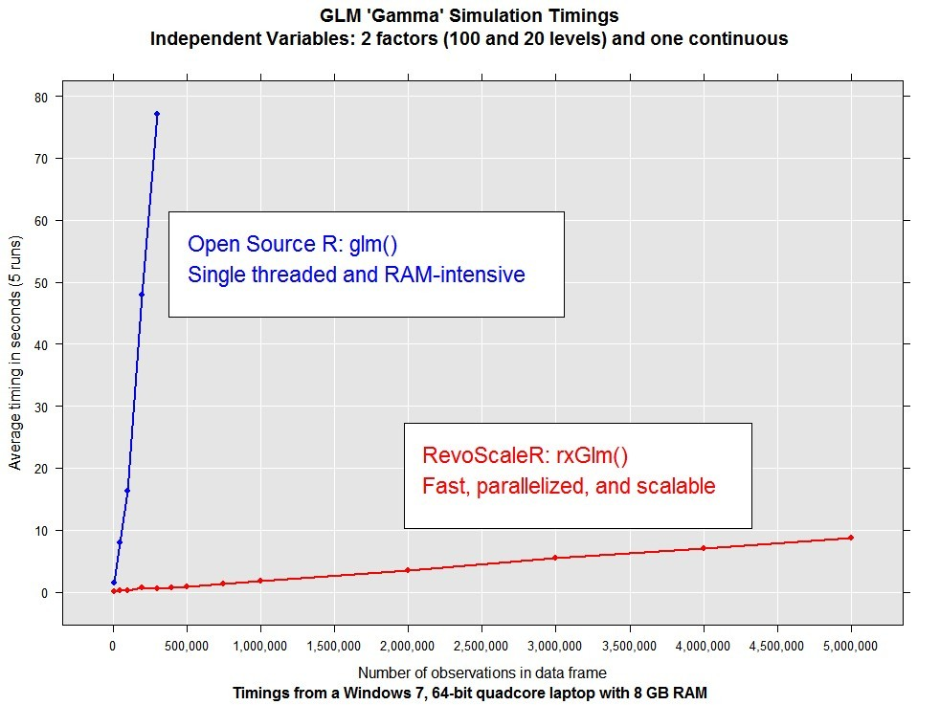

Slide 14











Linux, Windows, Hadoop & Teradata
High-performance, Scalable R
R Server Technology

Slide 15


Simplicity and agility
Scalability and choice
Cost effectiveness
Enterprise speed and
scale
Near-DB analytics
Parallel threading and processing
Reuse SQL skills for data engineering
In-database deployment
Memory and disk scalability
No R memory limits
Write once, deploy anywhere
Included in SQL Server 2016
Reuse and optimize existing R code
Eliminate data movement

Slide 16











Cloud
Hadoop & Spark
R Server portfolio
R Server Technology
EDW
RDBMS
Desktops & Servers
Write Once – Deploy Anywhere

Slide 18



Slide 20

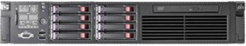
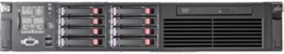
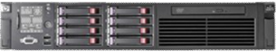

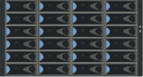






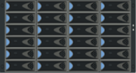





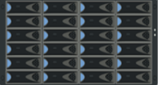




Distributed R - How Does Remote Compute Context ?
Microsoft R Server “Client”
Microsoft R Server “Server”
Analyze Blocks In Parallel
Load Block At A Time
Big Data
R IDE or command- line
Distribute Work, Compile Results
REMOTE CONTEXT
Algorithm Master
Predictive Algorithm
Results
“Pack and Ship” Requests to Remote Environments
Console
Microsoft R Server functions
A compute context defines where to process.
E.g. remote context like Hadoop Map Reduce
Microsoft R functions prefixed with rx
Current set compute context determines processing location
Copyright Microsoft Corporation. All rights reserved.

Slide 21




Slide 22










Data Step |  | Statistical Tests | Variable Selection
Data import – Delimited, Fixed, SAS, SPSS, OBDC |  | Chi Square Test | Stepwise Regression
Variable creation & transformation |  | Kendall Rank Correlation
Recode variables |  | Fisher’s Exact Test | Simulation
Factor variables |  | Student’s t-Test | Simulation (e.g. Monte Carlo)
Missing value handling |  | Sampling | Parallel Random Number Generation
Sort, Merge, Split
Aggregate by category (means, sums) |  | Subsample (observations & variables) | Cluster Analysis
 |  | Random Sampling
Descriptive Statistics |  |  | K-Means
Min / Max, Mean, Median (approx.)
 |  | Predictive Models
 |  |  | Classification
Quantiles (approx.) |  | Sum of Squares (cross product matrix for set variables)
Standard Deviation |  | Quantiles (approx.) | Decision Trees
Variance |  | Generalized Linear Models (GLM) exponential family distributions: binomial, Gaussian, inverse Gaussian, Poisson, Tweedie. Standard link functions: cauchit, identity, log, logit, probit. User defined distributions & link functions. | Decision Forests
Correlation |  |  | Gradient Boosted Decision Trees
Covariance |  |  | Naïve Bayes
Sum of Squares (cross product matrix for set variables) |  | Covariance & Correlation Matrices
 |  |  | Combination
Pairwise Cross tabs |  | Logistic Regression
Risk Ratio & Odds Ratio |  | Classification & Regression Trees | rxDataStep _{New}
Cross-Tabulation of Data (standard tables & long form) |  | Predictions/scoring for models | rxExec
Marginal Summaries of Cross Tabulations |  | Residuals for all models | PEMA-R API Custom Algorithms

Slide 23


Slide 24


Slide 25

X
D F
XDF

Slide 26





Slide 27


Slide 28




Slide 29



Slide 30


Slide 32


Slide 33



Slide 34




Slide 35




Slide 36



Slide 38


Slide 39


Slide 40


Slide 41






Slide 42



Slide 43




Slide 44










Slide 45


Slide 46




rxCrossTabs for frequency tables
rxCube for “long” tables
Requires factor inputs
Formula interface:

Slide 47






Slide 48


Slide 49




Slide 50










Slide 52





Slide 53







